Slide 1
Team PRINT
Rohith Chintala, Brendan Cutick, Tyler Han, Elizabeth Myers, Eric Oh, Aidan Sandman-Long, Cynthia Sheng, Nathan Spicer-Davis, Kenji Tsukamoto, Nick Webb, Erik Zavorin
We pledge on our honor that we have not given or received any
unauthorized assistance on this assignment.

Slide 2
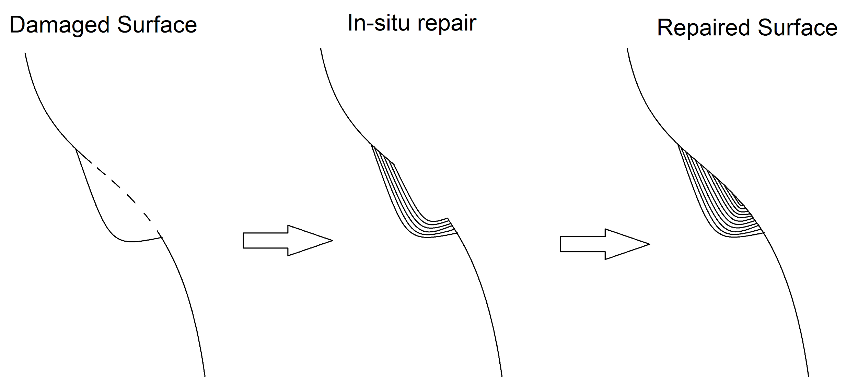
The Goal
Additive manufacturing solution to in-situ repairs
Additive Manufacturing - material is progressively added upon the previous structure
In-situ - in the natural environment; in place
Diagram of In-Situ Repair
Source: Team PRINT
Notes:
We’ll introduce our research first with the intentions as we aim to solve a problem with historically little research. We’d like to produce a device that is able to additively print repairs for some greater structure in the natural environment of its damage.

Slide 3
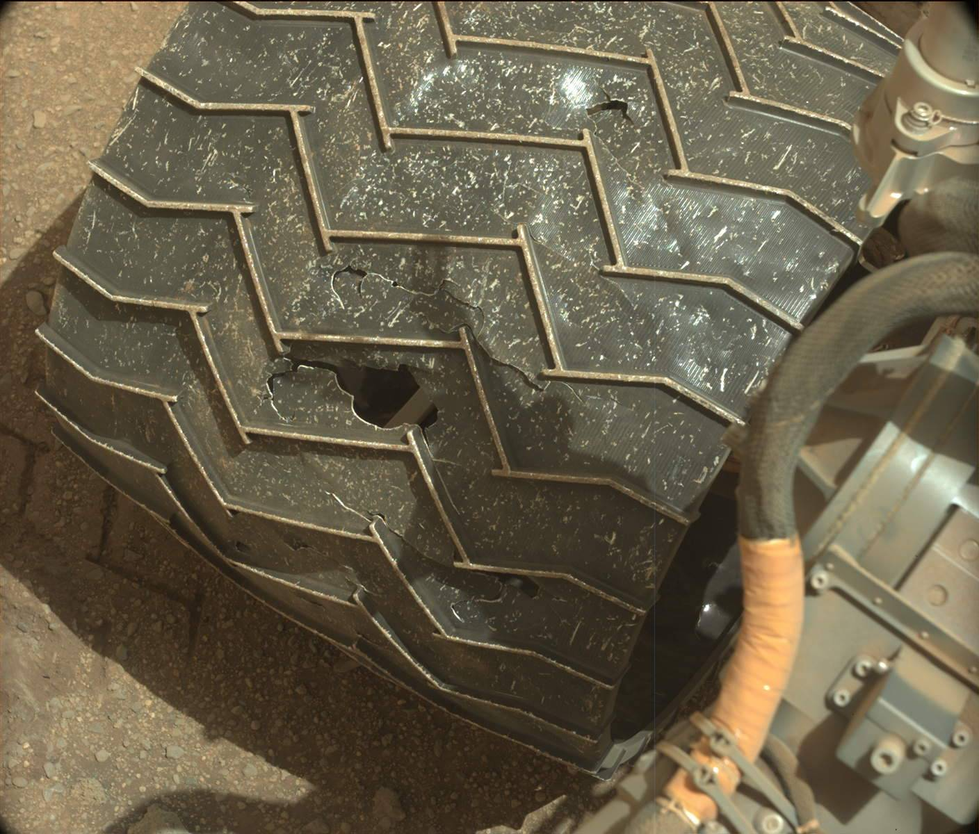
Why in situ printing?
Applications to space systems, airplanes, and virtually anything that needs repairs
Rovers, on-orbit satellite servicing, partially damaged structures
Image from MastCam of Mars Curiosity Wheel Damage Source: NASA/JPL-Caltech/MSSS, Sol 962: Mast Camera (Mastcam). 2015
Notes:
The problem associated with this goal is a very general one: damage to any and all structures. For future work, the technology may aim to be generalizable to any environment friendly to additive procedures. Of course, we narrow the scope of this problem to damages such as those found on rover wheels and plane wings. Repairs to structures such as these require either autonomy or high-precision. More of this will be discussed later (in summary of literature review).

Slide 4
Research Questions
What existing manipulators can optimally guide the print head in situ?
How can a traditional 3D printer extruder be modified for conformal printing?
How will the printer navigate through the environment?

Slide 5
Structures
Robotic Manipulator Selection and Control
Extruder Mount

Slide 6
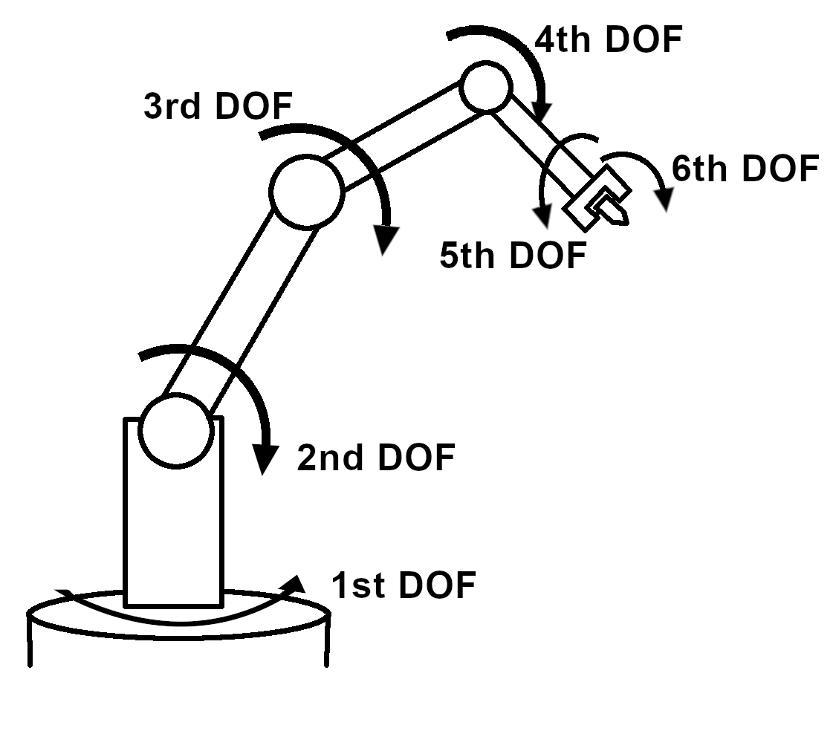
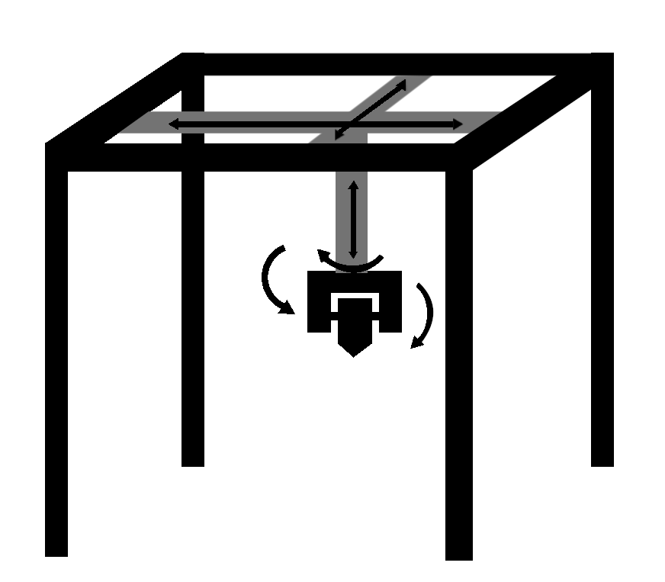
Robotic Manipulators
Robotic Arm
Traditional 3D Printer
Source: Team PRINT
Source: Team PRINT
Notes:
Background:
6 DOF are required for the project in order to print in situ
Robotic Arm:
Must attach extruder to robotic arm
More applicable to long-term goals
Expensive or non-exclusive use on campus
No need to add DOF
Traditional 3D Printer:
Extruder is already attached
Need to modify the printer to add DOF
Cheaper and easier to have exclusive use

Slide 7
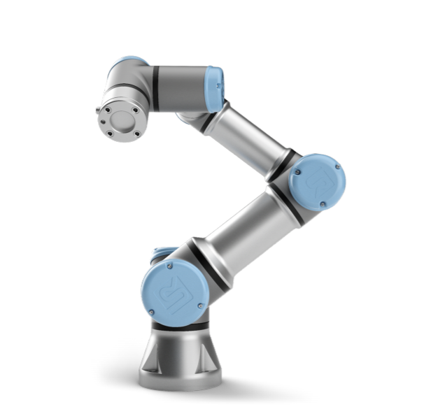
Universal Robotic Arms
UR3e model
3 kg payload
Six degrees of freedom
Pose Repeatability of ±0.03mm with payload
Suitable for 3D printing [8]
ROS-compatible
Source: [7]
Notes:
At a minimum, the UR3e seems to be required
It has a 3kg payload, 6 DOF, pose repeatability of +- 0.03mm with payload and we can use ROS.
If we need a higher payload we can use the UR5e, which has a 5kg payload and all other specs are the same.
https://s3-eu-west-1.amazonaws.com/ur-support-site/41166/UR3e_User_Manual_en_Global.pdf

Slide 8
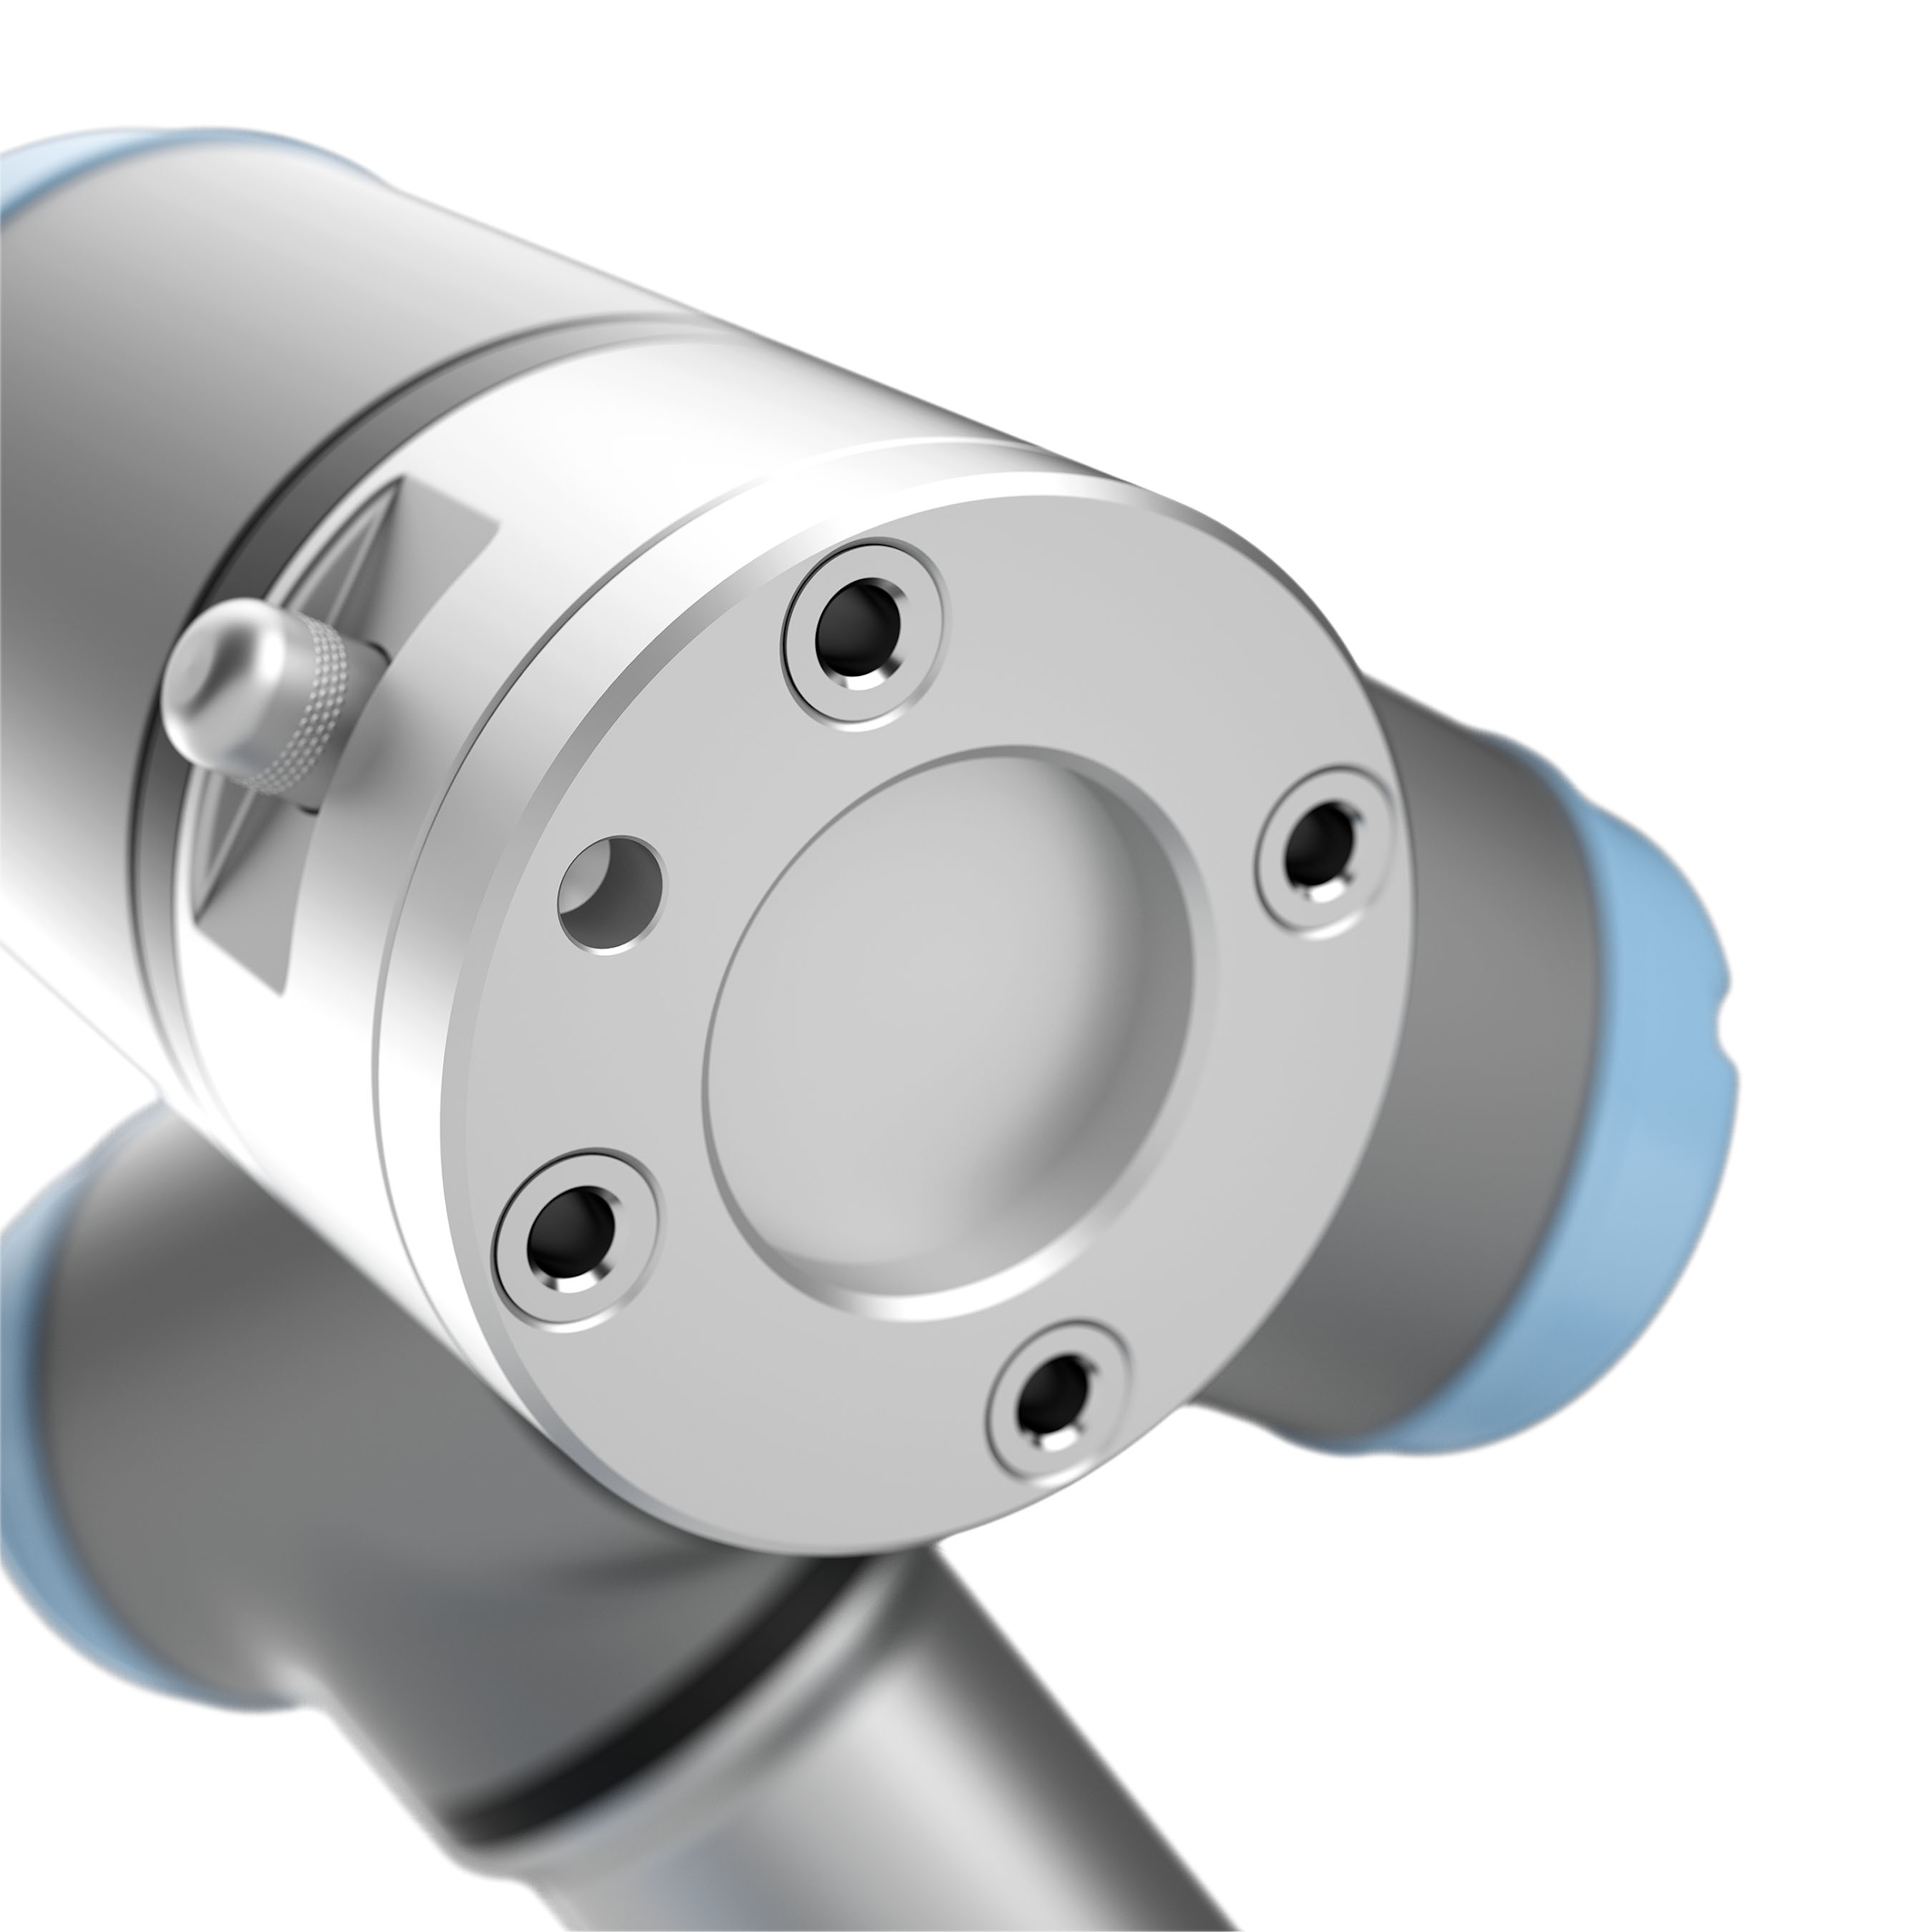
Mounting Extruder
ISO 9409-1-50-4-M6
8 pin connector provides 0V, 12V, or 24V
End Effector Mount will be made through 3D printing or CNC machine
Source: [7]
Notes:
The connector type is listed in the first bullet
Power requirements for the 3D printer could be provided through the arm itself
We will need to create our own custom mount
Picture: https://www.google.com/url?sa=i&url=https%3A%2F%2Fwww.scottautomation.com%2Fproducts%2Fur3e-universal-robot%2F&psig=AOvVaw14qEAmD2DmZgcuqONUZgHj&ust=1581541751705000&source=images&cd=vfe&ved=0CAIQjRxqFwoTCJD-0aS0yucCFQAAAAAdAAAAABAE

Slide 9
Extruder
Assembly and manufacturing
Thermal Properties
Notes:
The print head must be aware of its environment
Avoiding collisions
Basis for developing a suitable toolpath
Ranging Scans
Time-of-flight based
Laser Triangulation
Uses geometry of known locations of laser emitter and camera
Tactile Sensing
Thin sheets of force-sensitive resistors

Slide 10
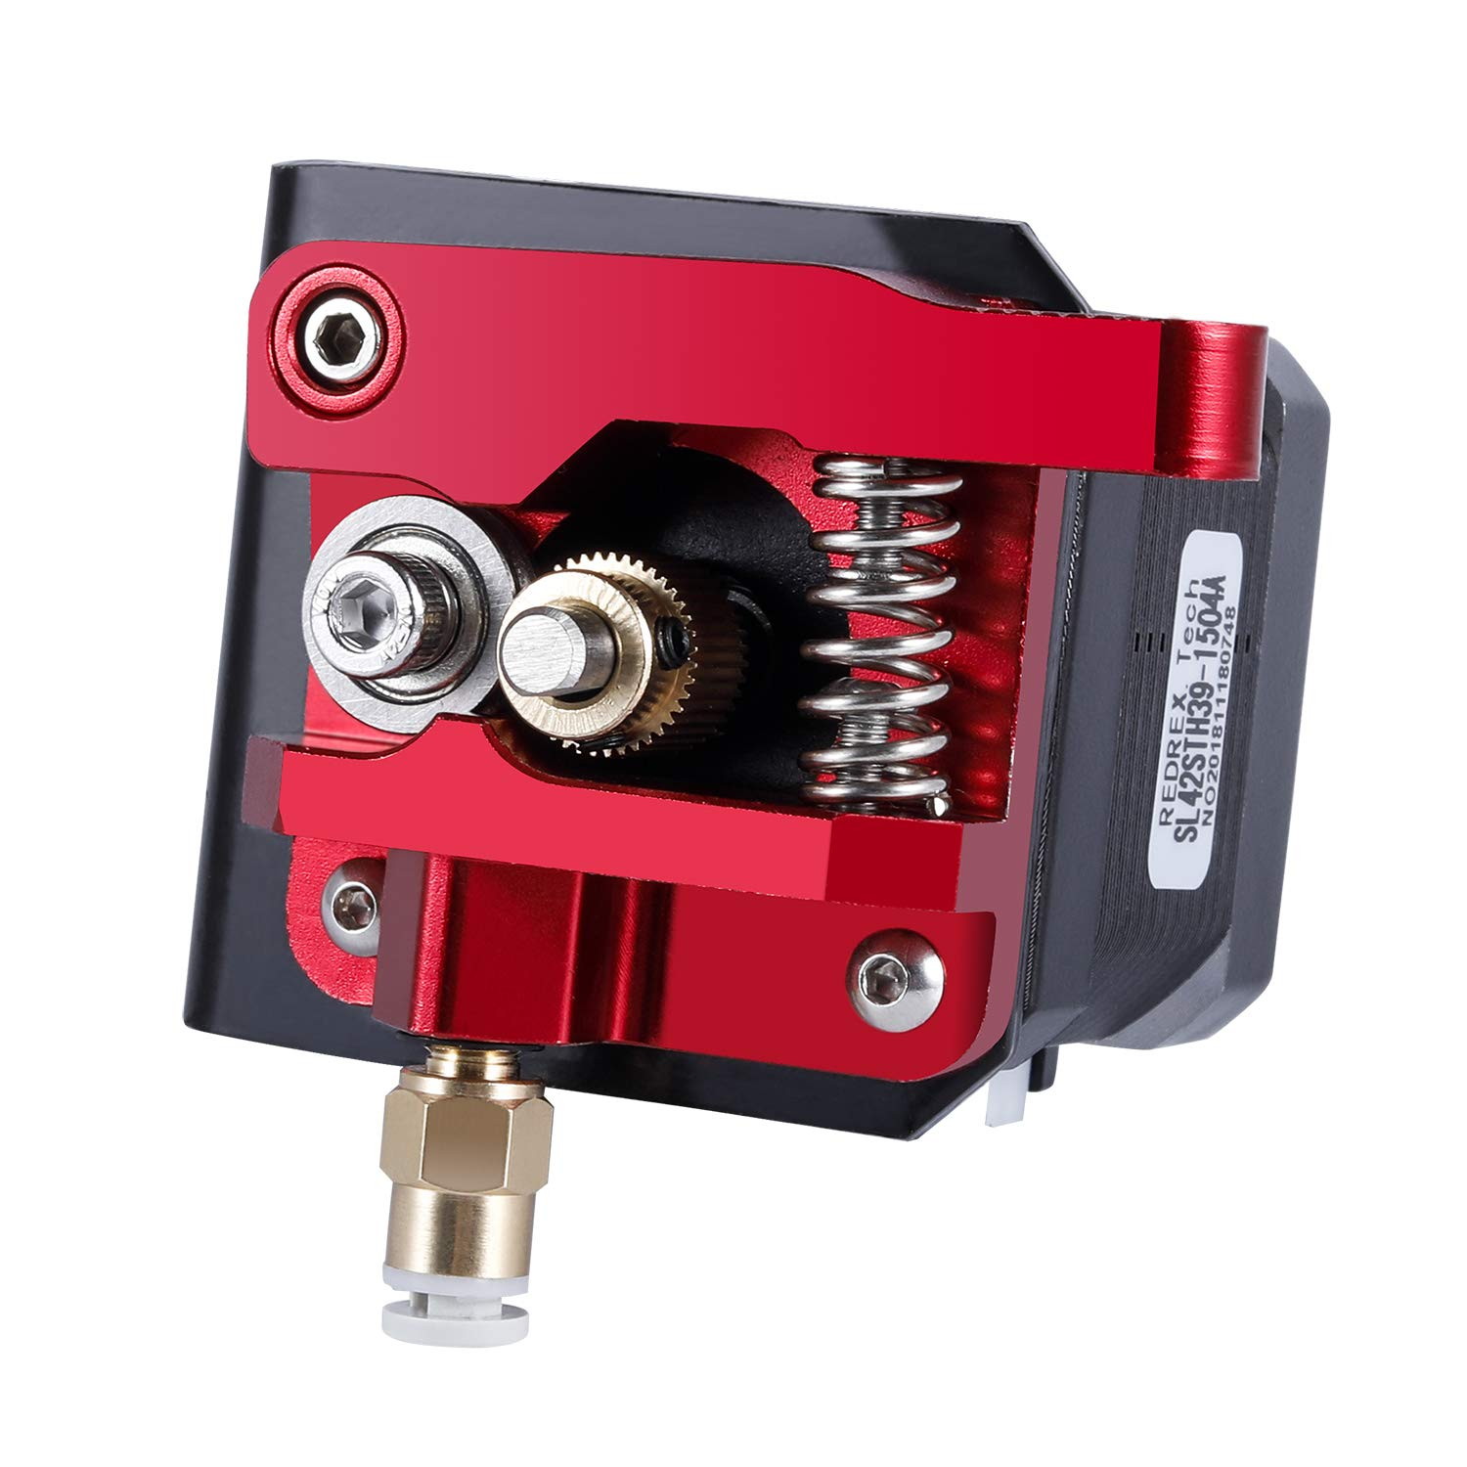
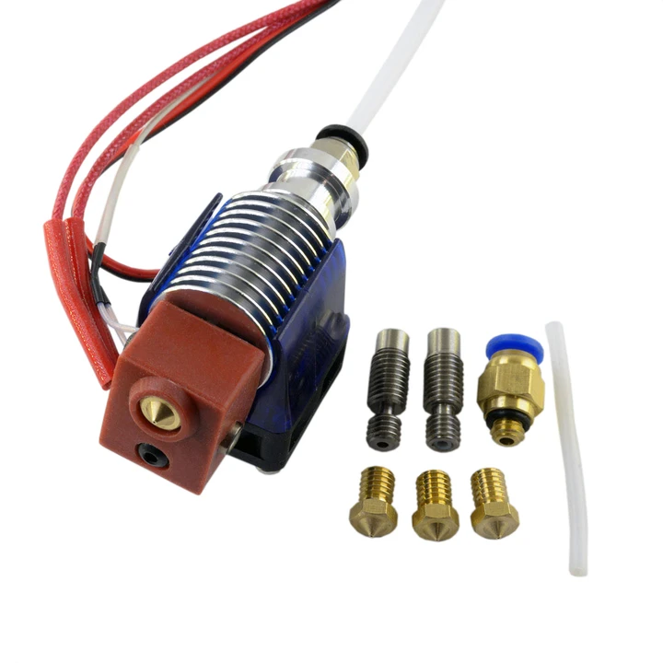
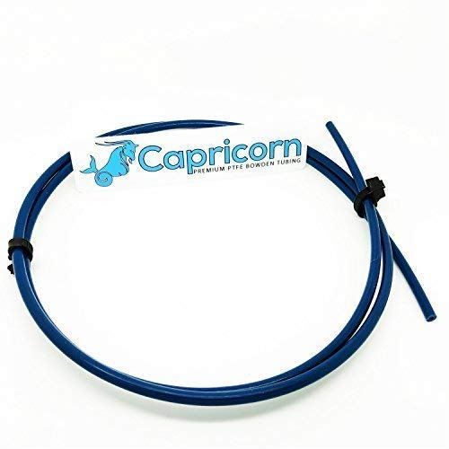
Assembly
Assemble premade parts
Cold/hot end, bowden tube
Lengthening extruder tip
Manufacture on campus
Notes:
Acquire parts from 3rd party. Describe how a bowden printer works. Move into manufacturing, plan on extending the length of the extruder tip.

Slide 11
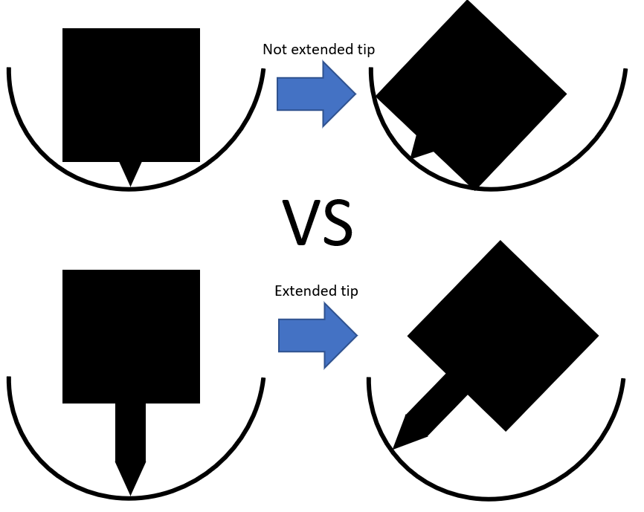
Manufacturing Extruder Tip
Extended extruder tip benefits and challenges:
Improved maneuverability
Extruder body won’t get stuck on the base
Maintaining heat through extended tip
Source: Team PRINT
Notes:
Why would we even do this? Improved maneuverability. Bulky hot end could interfere with our curved surfaces, to solve this we are lengthening the tip of the extruder. Most of the tip will now be exposed, thermal insulation may be a problem. We hope that by using a good thermal conductor like copper that this isn’t a problem, because the last thing we want is the PLA hardening in the new extruder tip.

Slide 12
3D Scanning
Surface Data
Collision Avoidance
Toolpath Planning
Notes:
In order to print into a priori-unknown environment. The printer must have information about its surface. This will help to avoid collisions and provide data on how to algorithmically create a suitable toolpath for manufacturing and navigation.
The primary types of scanners we would like to explore are ranging scanners, triangulation scanners, and tactile scanners. Ranging scanners are time-of-flight based and may be unsuitable for close-range scanning. However, they are comparatively simple with regards to deployment and noise. Triangulation scanners take advantage of the known geometry of the laser emitter and the camera. In contrast to ranging scanners, they are suitable for close-range scans but susceptible to noise. Tactile sensing is a scanning method that would be isolated to an environment that is insensitive to physical interaction (environments that are excluded are those with electronics or loose or moving parts). However, they provide a method for edge detection that is vital to computing edges and boundaries for generating a toolpath. The print head must be aware of its environment
Avoiding collisions
Basis for developing a suitable toolpath
Ranging Scans
Time-of-flight based
Laser Triangulation
Uses geometry of known locations of laser emitter and camera
Tactile Sensing
Thin sheets of force-sensitive resistors
The first step toward planning a toolpath is obtaining the surface data of the print. The data should allow us to perform collision avoidance algorithms and prepare a toolpath plan that is suitable for the topology of the surface.

Slide 13
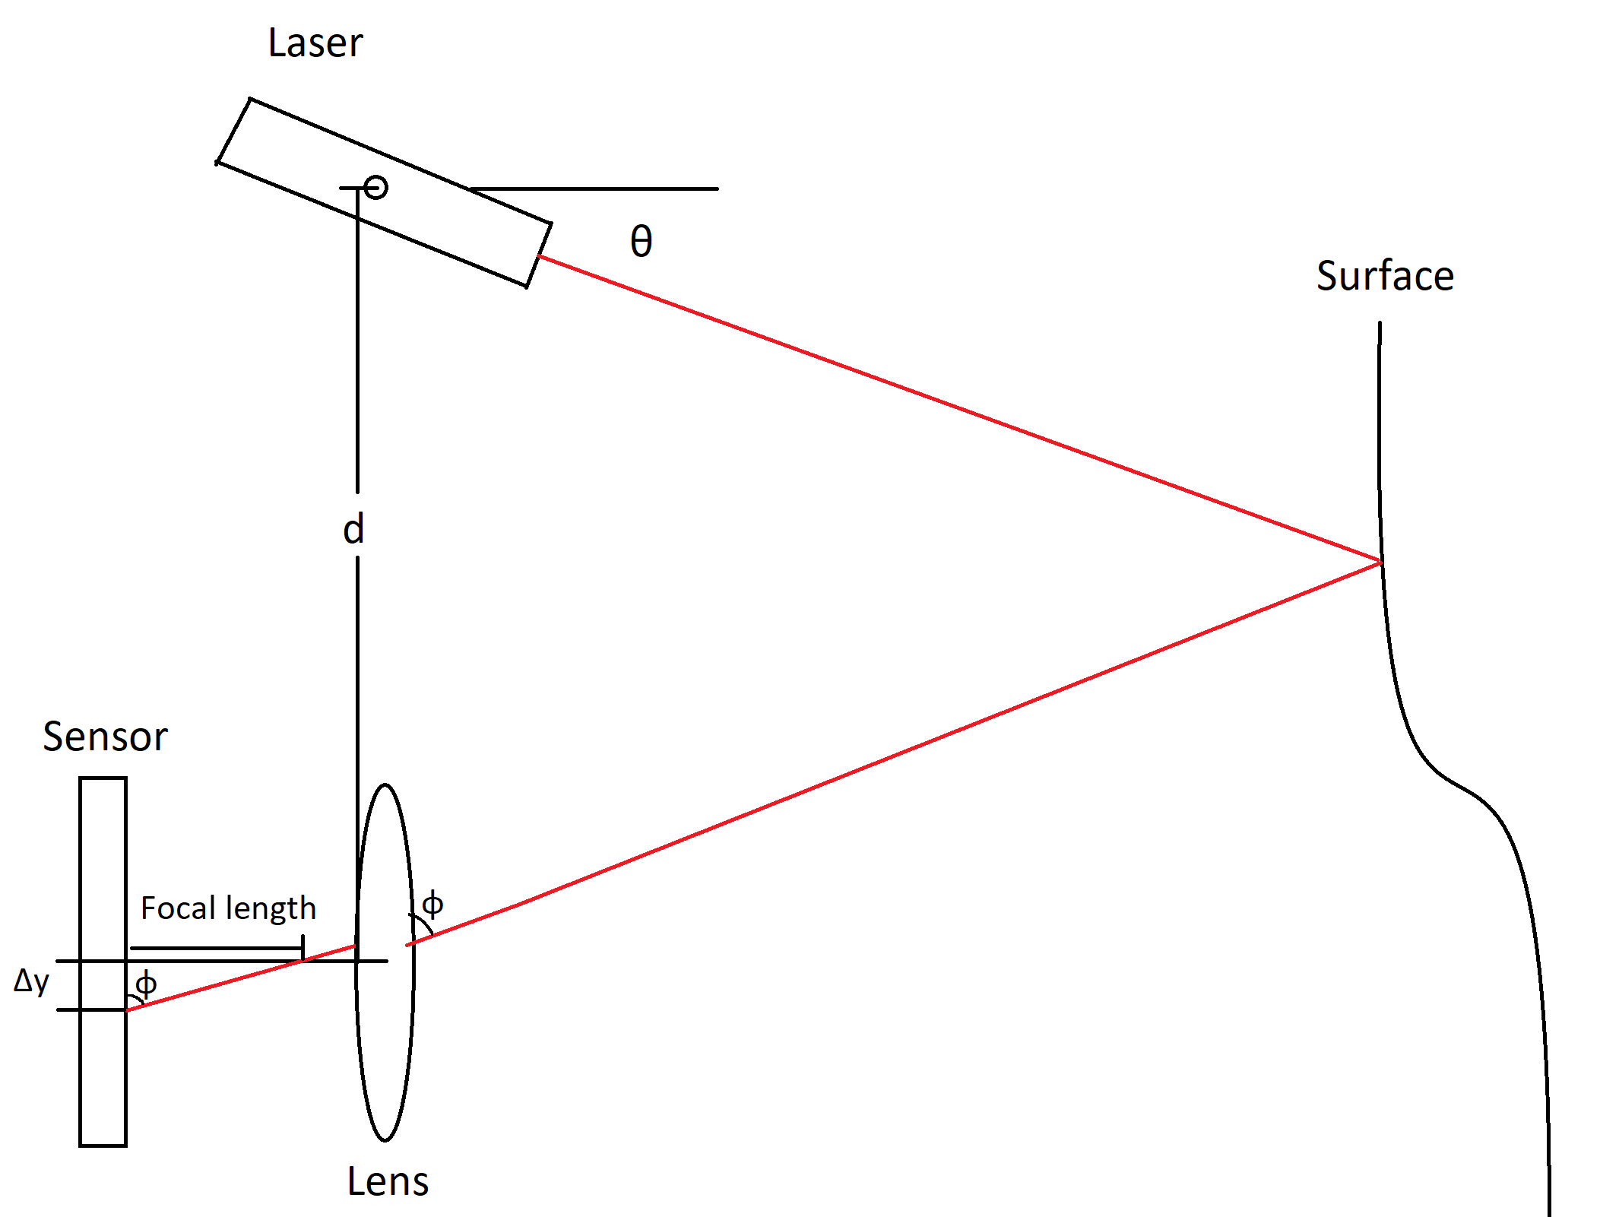
Scanning Methods
LIDAR based time-of-flight
Laser Triangulation
Tactile Sensing
Diagram of Triangulation Scanning Method
Source: Team PRINT
Notes:
Boehler et al. notes that close-range time-of-flight scanning instruments may have errors in the range of some millimeters [27]. Considering that commercial 3D printers offer nozzle sizes in the range of tenths of millimeters, error of this magnitude is undesirable as this would cause misalignment or overall failure over multiple layers. An implementation of in situ printing utilizing ranging techniques would require additional consideration of the suitable print profile and improved filtering methods (discussed below).
Talk about noise
There are various scanning methods that can be used to obtain this surface data. The choices are time-of-flight scanning, laser triangulation, and tactile sensing. In our review of current research, it appears that time-of-flight based scanning is unsuitable for close-range tasks as it produces error in the range of tenths of millimeters. Error in this range can cause noticeable effects in the quality of printed layers as the extrusion profile is typically in the range of tenths of millimeters as well [27].
Tactile sensing is a secondary method of scanning that we briefly looked into in our review. Unlike laser point cloud scanning, tactile sensing directly offers the ability to detect boundaries and edges. This could be useful for the planning algorithm and would not require further processing.
[27] W. Boehler and A. Marbs, “3D Scanning Instruments,” Proc. CIPA WG, pp. 9–18, 2002.

Slide 14
Planning
Algorithms for:
Collision Avoidance
Toolpath Generation
Notes:
Once the surface data is obtained and prepared for analysis, we can move on to developing a toolpath for the environment. Any such toolpaths would have to take into account self-collision and print collisions. We would also like to have toolpath generation be generalizable to most concave topologies so a general algorithm would ideally be developed.

Slide 15
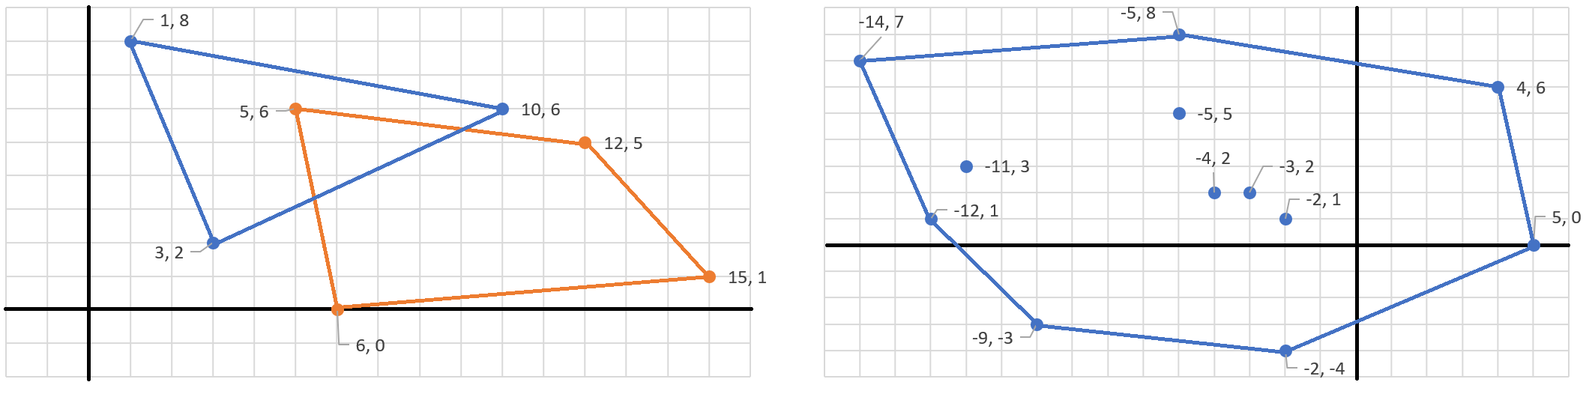
Planning
Toolpath generation
Iso-curves
Rain-trapping algorithm
Collision Avoidance via Oriented Bounding Boxes
Source: Team PRINT
Two Convex Polygons
Minkowski Difference
Notes:
In our review of current research, a tested method of topological analysis and slicing is the usage of iso-curves [3]. This method takes a projection of the surface and reproduces layers resembling the surface upwards to create the layer spaces. A print object could then be created using an AND operation between the point clouds of the object and the projected layers, effectively producing the sliced toolpath.
An alternate method may be to resort to non-conformal printing and implement what’s known as the rain-trapping algorithm in computer science. This algorithm determines local minimums given a surface in 3D space and provides a method for locating the necessary points at which material extrusion is needed.
[3] N. Bausch, D. P. Dawkins, R. Frei, and S. Klein, “3D Printing onto Unknown Uneven Surfaces**This work is supported by the University of Portsmouth – Research Development Framework (RDF) 2015.,” IFAC-Pap., vol. 49, no. 21, pp. 583–590, Jan. 2016, doi: 10.1016/j.ifacol.2016.10.664.

Slide 16
Software
Data Pipelining
Software-side Filtering
Algorithm Implementation
Manipulator Control
Notes:
Most of sensing and planning requirements can be tested and demonstrated independently of the other subteams through software. The corresponding tasks involve data pipelining between the hardware and data manipulation scripts. We can also perform filtering on our data using the open source Point Cloud Library package.

Slide 17
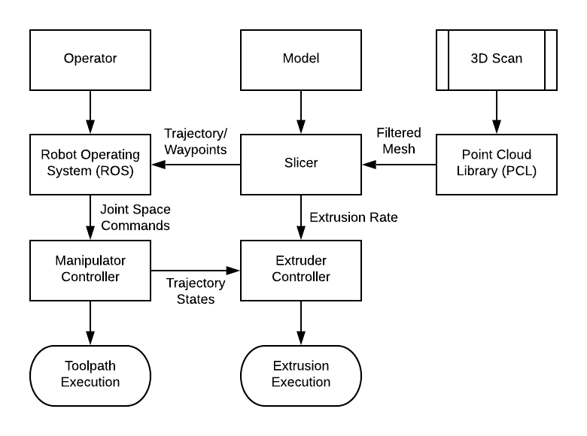
Source: Team PRINT
Logical Block Diagram for Information Flow
Notes:
Here is the logical block diagram for our system.

Slide 18
Testing
Individual Sub-team Testing
Integration Testing

Slide 19
Structures Testing
ROS simulations
Accuracy and Precision of UR3e
With and Without Mount
Thermal Testing of Extruder Mount

Slide 20
Extruder Testing
Thermal dissipation in extruder tip
Control tube feed rate
Notes:
Assuming a constant temperature, we hope to model the behavior of the system using differential equations where the gear turn rate is the input and extrusion rate is the output.

Slide 21
Sensing Testing
Manipulator Control in Simulation
Scanning Feedback
Filtering Configurations and Optimization
Testing for minimum resolution
Toolpath Generation in Simulation
Notes:
We’ll test the data qualitatively by comparing the returned point cloud surface with the actual surface of a scan. Algorithm implementation and manipulator control can be done in simulation in ROS. Most of these criteria can be determined successful simply by pass/fail. The point cloud surface filtering will be successful if it can limit errors to around hundredths of a mm - this would imply a maximum 10% error for each printed layer.

Slide 22
Integration Testing
Integrate structures and extruder
Print on flat surface
Print model
Merge sensing
Test semi-automated in situ prints
Notes:
Print a small amount of layers on a flat surface
Extrusion rate and arm speed go hand in hand, otherwise there may be material build ups or gaps
Print a curve on a vertical plane
Print on a similar 3D geometry to our goal print surface

Slide 23
References
[1] N. Bausch, D. P. Dawkins, R. Frei, and S. Klein, “3D Printing onto Unknown Uneven Surfaces**This work is supported by the University of Portsmouth – Research Development Framework (RDF) 2015.,” IFAC-Pap., vol. 49, no. 21, pp. 583–590, Jan. 2016, doi: 10.1016/j.ifacol.2016.10.664.
[2] N. Bausch, D. P. Dawkins, and R. Frei, “InSPIREd - advances in Conformal Printing: 3D printing onto unknown uneven surfaces,” in 2017 IEEE International Conference on Advanced Intelligent Mechatronics (AIM), Munich, Germany, 2017, pp. 430–435, doi: 10.1109/AIM.2017.8014055.
[3] NASA/JPL-Caltech/MSSS, Sol 962: Mast Camera (Mastcam). 2015.
[4] J. B. Campbell, Introduction to remote sensing, 2nd ed. New York: Guilford Press, 1996.-Oct-2019].
[5] M. De Geir, “Control of a robotic arm: Application to on-surface 3D-printing.” 2015.
[6] A. V. Shembekar, Y. J. Yoon, A. Kanyuck, and S. K. Gupta, “Generating Robot Trajectories for Conformal Three-Dimensional Printing Using Nonplanar Layers,” J. Comput. Inf. Sci. Eng., vol. 19, no. 3, p. 031011, Apr. 2019, doi: 10.1115/1.4043013.
[7] Universal Robots A/S, “Universal Robots e-Series User Manual.” Universal Robots A/S, 2018.
[8] J. R. Kubalak et al., “Design and realization of a 6 degree of freedom robotic extrusion platform,” in Solid Freeform Fabrication Symposium, 2016, pp. 1314–1332.

